Slide 1
Panorámica internacional de la fiscalidad ambiental
CONAMA2016 – ST-34.- Fiscalidad Ambiental
Rozan Consten

Slide 2
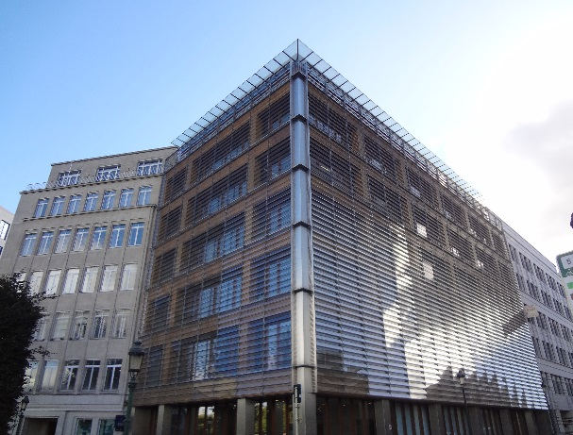
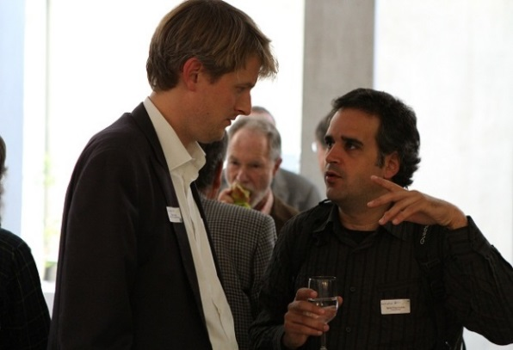
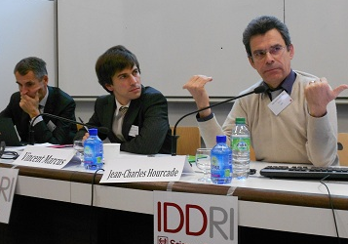
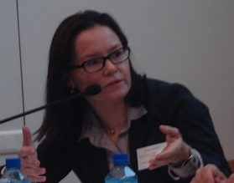
Green Budget Europe
Se fundó en 2008
Plataforma de expertos europeos, oficina en Bruselas
Promoción de instrumentos basados en el mercado
Misión:
Une economía de mercado social y sostenible, que señaliza los costes reales y corrige los efectos negativos
Notes:
Vision: an ecological and social market economy, in which ‘prices tell not only the economic, but also the ecological truth’

Slide 3
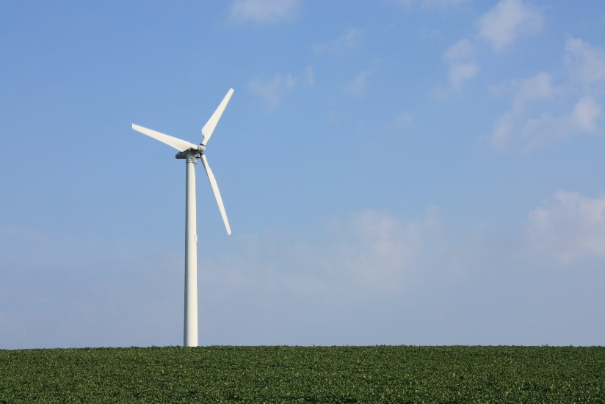
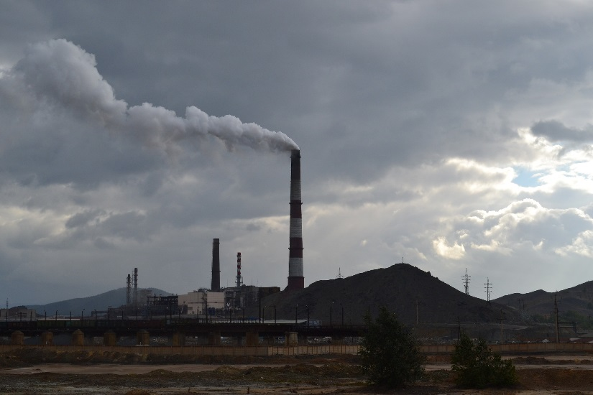
Contenido
Acuerdos internacionales
Compromisos y reglamentos de la UE
España en comparación
Ejemplos de fiscalidad ambiental en otros países
Enseñanzas adquiridas

Slide 4
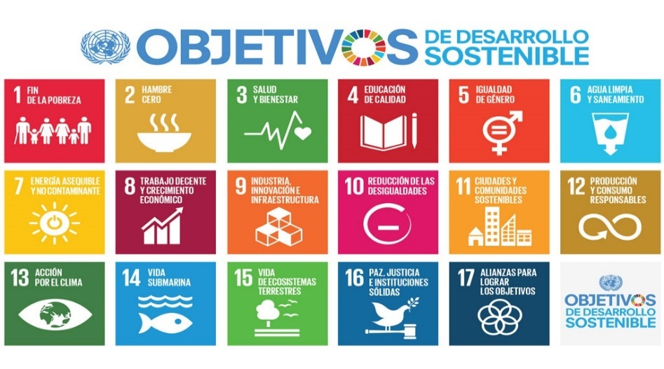
Acuerdos internacionales
Acuerdo de Paris: “Situar los flujos financieros en un nivel compatible con una trayectoria que conduzca a un desarrollo resiliente al clima y con bajas emisiones de gases de efecto invernadero.” Articulo 2
Objetivos de Desarrollo Sostenible
Salud y bienestar, agua limpia y saneamiento, energía asequible y no contaminante, trabajo decente y crecimiento económico, industria, innovación e infraestructura, producción y consumo responsables
Notes:
Paris agreement: ‘Making financial flows consistent with a pathway towards low greenhouse gas emissions and climate-resilient developments.’
SDGs: Good health and Well-being, Clean water and sanitation, Affordable and clean energy, Decent work and economic growth, Industry, Innovation and Infrastructure, Responsible consumption and production

Slide 5
Compromisos de la UE
UE marco en materia de clima y energía para 2030:
40% reducción de las emisiones de gases de efecto invernadero (1990)
27% energía renovable
27% eficiencia energética
Estrategia Europa 2020 para el crecimiento y la ocupación: sugiere un cambio del modelo fiscal en el que los impuestos al trabajo y al consumo se reduzcan como contrapartida a la subida de los impuestos medioambientales y energéticos.
Notes:
Europe 2020 strategy: sustainable growth for a more resource efficient, greener and more competitive economy: demand for ETR/tax shift

Slide 6
Reglamentos EU
Directiva sobre la imposición de la energía (2003): tipos mínimos del impuesto especial para casi todos los productos energéticos. 2011: propuesta de revisión, fracasó en el Consejo de Ministros en 2015.
Régimen de comercio de derechos de emisión de la UE (2005): actualmente en revisión.
Semestre Europeo (2010): coordinación de políticas presupuestarias, económicas, de empleo – recomendaciones especificas por país.
Notes:
ETD revision aimed to modernize EU rules on energy taxation: two components: CO2 emissions and energy content.
ETS problems: low price 5€/tCO₂ instead of 80, overcapacity,
European Semester: coordination of budgetary, economic and employment policies. Uncertain what will happen to this with Energy Union coming.

Slide 7
España: Déficit publico

Slide 8
Por su compromiso con el cambio climático
Fuente: Elaboración propia a partir de Eurostat: Europe 2020 targerts CO2 emissions

Slide 9
Fiscalidad ambiental en % de PIB en 2012
Source: Eurostat (2015): Taxation Trends in the European Union.

Slide 10
Ejemplos de fiscalidad ambiental
Comprehensive ETR:
Denmark 1992/3/6/2000-2
Netherlands 1991/96/2001
Norway 1991/1997/9
Sweden 1991/3/7/2000-2010
United Kingdom 1993/6/2001/3
Elements of an ETR:
Finland 1990/7 (introduced the first CO₂-tax in 1990 worldwide!)
Germany 1999-2003
Italy 1999
Switzerland 1997/2006
Estonia 2006-8, 2009-2013
Ireland 2009
Modest approaches to an ETR:
Austria 1996/2004
Belgium 1993
Slovenia 1997/1998

Slide 12
Fiscalidad ambiental en el Portugal
Reforma lanzada en 2014, creación de Comisión de Reforma Fiscal Verde, convertido en ley en 2015 como parte del presupuesto del Estado
Principales medidas:
Imposición de gases de efecto invernadero
Impuesto bolsas plástico
Promoción de vehículos menos contaminantes
Mejor fiscalidad de los residuos y agua
Ingresos utilizados para reducción del impuesto sobre la renta
Éxito: debate RFM, clara señal a los mercados, cambio de comportamiento
Notes:
Reform launched in 2014, EFR commissions created, put into law in 2015 as part of the state budget
Main measures: taxes on greenhouse gases, plastic bag tax, promotion of less polluting vehicles, better water and waste taxes, revenues used to lower income taxes
Success: EFR in public debate, carbon tax clear signal for markets, plastic bag tax: behavior change

Slide 13
Enseñanzas adquiridas
Teoría y observaciones empíricas indican que RFM es buena idea
Importante profundizar la reflexión sobre:
Uso de los ingresos tributaros: neutralidad de ingresos, aumentación de beneficios medioambientales (tecnología y cambio de comportamiento, asignación de fondos, consolidación fiscal)
Impacto en los grupos más desfavorecidos
Efectos negativos y positivos sobre actividades económicas (industrias con uso intensivo de energía, nuevas fuentes de ventajas competitivas)
Nivel impositivo general
Necesidad de une trama irresistible
Notes:
Consideration needs to be given to:
Use of the tax revenues: revenue neutrality, amplify environmental benefits (technology and behaviour change, earmarking), fiscal consolidation
Impact on already disadvantaged groups
Negative and positive effects on business (energy intensive industries, new sources of comparative advantage as the basis for new businesses)
Overall level of taxation
The politics is difficult: need to develop a compelling narrative
,

Slide 14
Please join us and share our vision of Europe as a pioneer of green fiscal policy, green technology and a green economy!
Become member of GBE, and be a part of a unique, non-profit expert platform on environmental fiscal reform!.
Rozan Consten
rozan.consten@green-budget.eu

Slide 16
Macroeconomic Imbalance
Climate, energy and environmental goals

Slide 17
Nr 5 guidelines for the employment policies of the Member states for 2015 (EU 2025/1848 pr 5 October 2015)
The tax burden should be shifted away form labour to other sources of taxation less detrimental to employment and growth, while protecting revenue for adequate social protection and growth enhancing expenditure

Slide 18
A well-designed tax system allows
to raise sufficient revenues to finance socially-desired public expenditure
and support growth, jobs, and investment.
Aim of the Semester:
Develop growth-friendly tax structures
Improve tax governance / design in their efficiency and fairness dimensions.

Slide 19
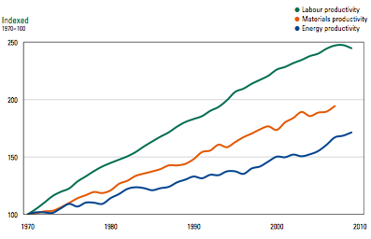
Businesses need adequate price signals for their investment decisions
Labour producitivity, ressource productivity and energy productivity EU-15 1970 – 2010 (1970 = 100%)
Labour
Resources
Energy

Slide 20
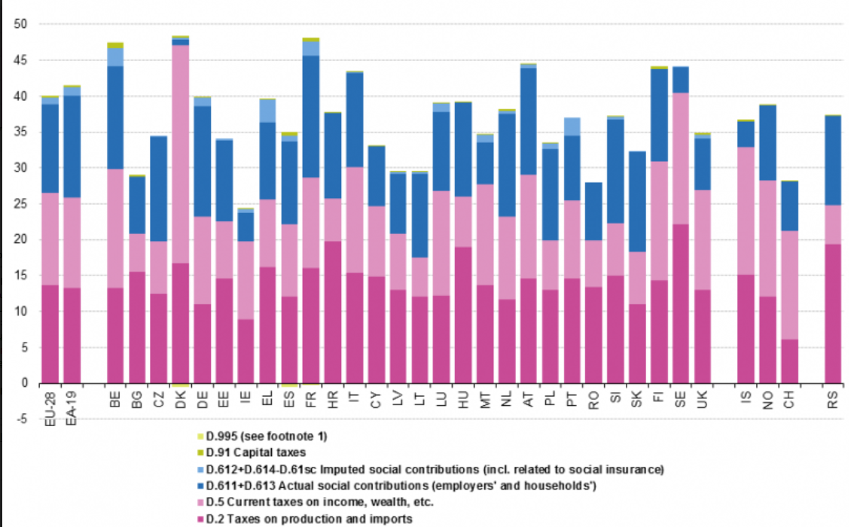
Breakdown of tax revenue by EU Member State by main tax categories (% of GDP) 2014
Notes:
Taxes on production and imports accounted for 13.6 % of GDP and current taxes on income,
wealth, etc. stood at 13.0 % of GDP.
Current taxes on income, wealth, etc. as a % of GDP decreased from 2007 to 2010, but a slight increase was seen in 2011 followed by stronger increases in 2012 and 2013.
While the ratio of current taxes on income, wealth, etc. remained stable between 2013 and 2014, a slight increase (0.1 pp. of GDP) was observed between 2014 and 2015. From 2014 to 2015, the share of (net) social contributions decreased by 0.2 p.p. to 13.2 % of GDP.

Slide 21
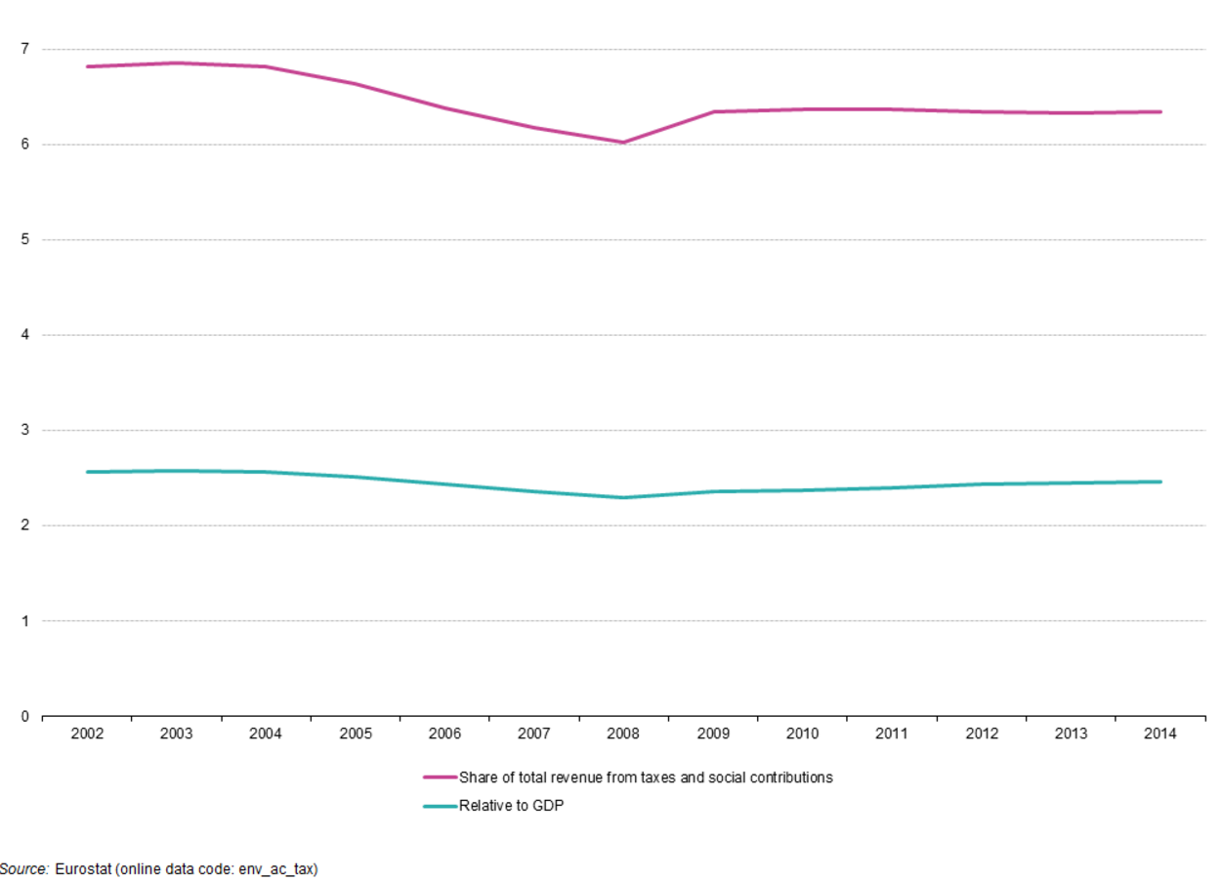
Stagnating share of environmental taxes (in % of total revenues from taxes and social contribution, EU-28)
Share of total revenue from taxes and social contributions
Relative to GDP
Source: Eurostat, 2016 (online data code: env_ac_tax)

Slide 22
Increase taxes on activities harmful to the environment
Tax what you burn…. ….not what you earn
Notes:
In 2005, the EEA defined ENVIRONMENTAL TAX REFORM – sometimes also referred to as the green tax shift – as follows:
Environmental tax reform (ETR) is a reform of the national tax system where there is a shift of the burden of taxation from conventional taxes, for example on labor, to environmentally damaging activities, such as resource use or pollution. The burden of taxes should fall more on 'bads' than 'goods' so that appropriate signals are given to consumers and producers and the tax burdens across the economy are better distributed from a sustainable development perspective.
The economic rationale is that welfare gains are generated by reducing taxes on labor or capital and increasing taxes on externalities and hence helping to avoid 'welfare-reducing' activities.
A typical case is an increase in the tax on energy, and a simultaneous reduction in labor taxes or social security contributions.
The underlying principle is shown on the slide:
Red Arrow
Increasing taxes / the fiscal burden makes environmentally harmful behaviour more expensive, creating a price incentive for people to do it less.
The advantage of introducing a fiscal mechanism is that it creates flexibility in the economy – the entity (person / business) can respond flexibly to the increased cost and find the least-cost solution (increased efficiency, alternative technologies, changed behaviour, etc.).
Green Arrow
Lower income taxes / social security contributions is the classical example of a “green tax shift” in OECD countries.
However, in developing countries, other uses for revenue raised from EFR measures may be more relevant, e.g. investment in water supply & sanitation, environmental clean-up, poverty alleviation programmes, public health, etc.
The underlying premise of a green tax shift is that we should increase the fiscal burden on things that are ‘bad’ for the environment e.g. fossil fuels, emissions of effluent into water, while decreasing the fiscal burden on things that are ‘good’ for it or at least neutral, e.g. labour.
This can be summarised by “click” this slogan widely used to communicate the underlying principles of ETR – or this phrase “click” used e.g. by EU Climate Commissioner Connie Hedegaard.

Slide 23
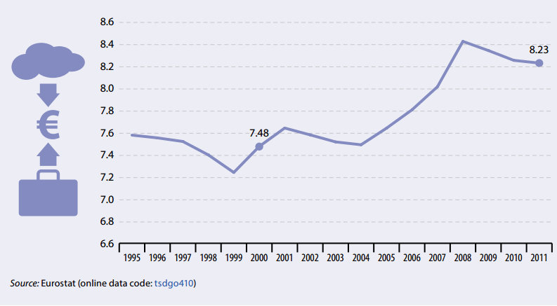
10,1% increase in ratio of labour to environmental taxes, EU-27 between 2000 and 2011
This clearly counteracts the EU goal to “green the tax system”

Slide 24
Hybrid legal architecture
Stability and Growth Pact
TFEU Art. 121 + Six-Pack
Europe 2020 headline targets
Medium-term Budgetary Objectives (MTO)
Macroeconomic scoreboard
Integrated Guidelines
Fiscal surveillance
Macroeconomic
surveillance
Thematic surveillance
Stability or Convergence Programmes
National level
National Reform Programmes
EU level
Annual Growth Survey
Country Specific Recommendations

Slide 25
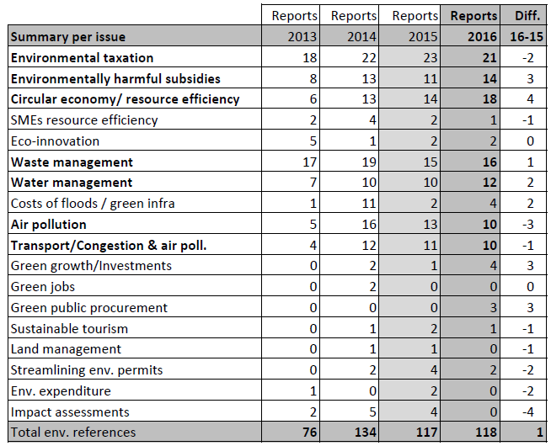
Let‘s proof it: Country Reports of the EC 2013-2016
source: European Commission, DG Environment (2015 and 2016) Country Reports

Slide 26
Please join us and share our vision of Europe as a pioneer of green fiscal policy, green technology and a green economy!
Become member of GBE, and be a part of a unique, non-profit expert platform on environmental fiscal reform!.
Rozan Consten
rozan.consten@green-budget.eu

Slide 27
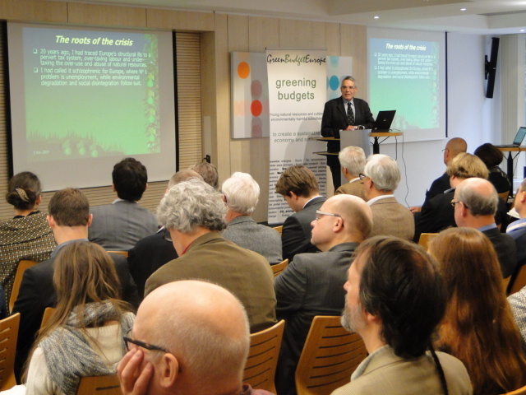
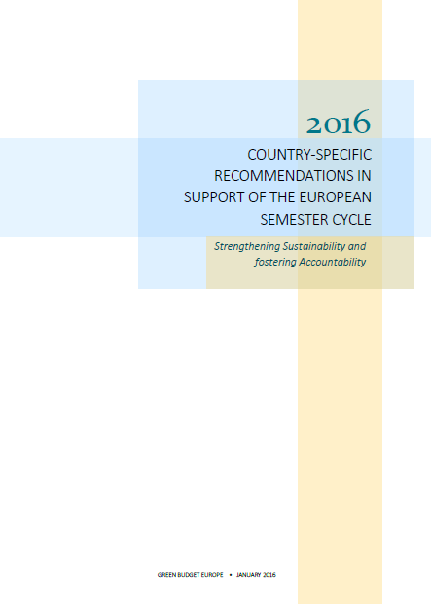
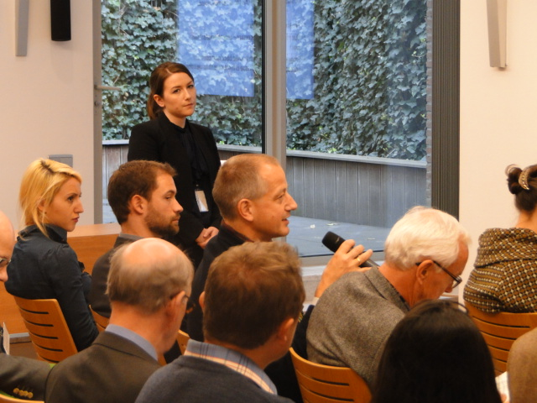
Green Budget Europe´s activities
Developing “alternative CSRs” and policy briefings
Continuous capacity building among members and partners
Organising conferences in Member States and Brussels
Lobby European Commission (Sec Gen, Juncker Cabinet and VP Cabinets, DG ECFIN, ENVI and CLIMATE), Hearings (EP), ESOs
Member of European Commission Experts Group “Greening the European Semester”
Monthly NGO Semester Roundtables (EEB, WWF, CEE Bankwatch, CAN, HEAL) in Brussels
EU Alliance for a democratic, social and sustainable European Semester (semesteralliance.net)
Energy Union design options

Slide 28
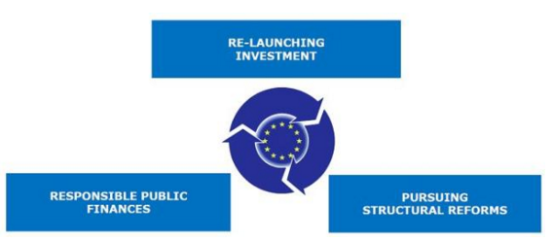
2016 Annual Growth Survey
Main priority: Growth and Jobs –but what kind of growth and which jobs?

Slide 29
The “Juncker Semester“: Streamlining
Energy ➔ Energy Union
Climate ➔ ?
Less CSRs in line with Juncker´s 10 priorities
CSRs need to deliver within 18 month
Eurozone CSRs in November (together with AGS)

Slide 30
Climate and Energy in Annual Growth Surveys
Environmentally Harmful Subsidies
Environmentally Tax Reform
Renewable Energies and Energy Efficiency
Circular Economy and Resource Efficiency
 | 2011 | 2012 | 2013 | 2014 | 2015 | 2016

Slide 31
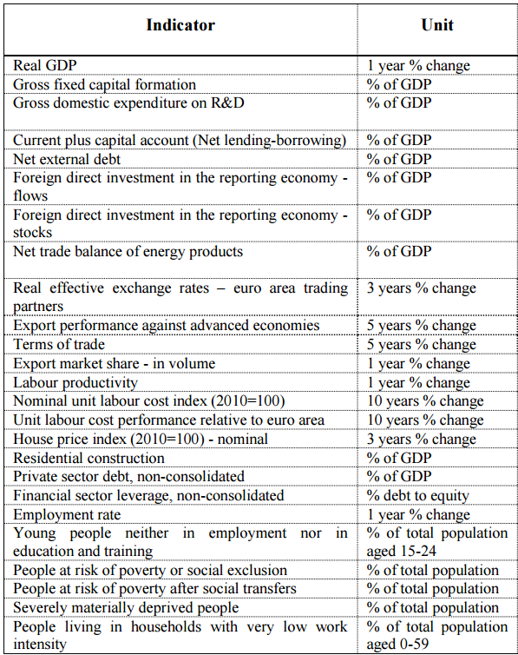
Scoreboard of Indicators 2017 Auxiliary Indicators
Resource efficiency indicator to be included in scoreboard of indicators
RATIONALE:
Further economic growth will only be possible if absolute decoupling from resource use is achieved
Increasing resource efficiency leads to job creation and an increased supply security
Increasing resource efficiency leads to lower environmental impacts, better health and a higher level of well-being
Circular Economy has got to be embedded in the Semester
The tax burden needs to be shifted from labour to resource use and the use of eco-system services

Slide 32
